Slide 1





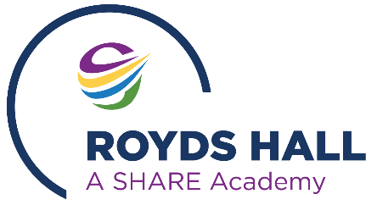
Teacher Assessed Grade (TAG) Student Representation
Royds Hall
Spring 2020

Slide 2

Student Representation
TAGs will be determined using a wide range of evidence to ensure it is representative of what a student knows, understands and is capable of.
The evidence to be used in determining a TAG is communicated to students and parents/carers early in the process.
This will include the details of the evidence to be used but WILL NOT include the grade to be submitted to the Awarding Bodies.

Slide 3
Student Representation
Students, supported by their parents/carers and assisted by their academy, can make a Representation to the academy if they feel the evidence to be used is not representative of their ability and knowledge.
The opportunity to make a Representation is to ensure no student is unduly disadvantaged by the use of a particular piece of evidence, when there are mitigating circumstances that prevented the student producing the work they are capable of for a specific piece of evidence.

Slide 4
Student Representation
Examples of reasons why a student may not feel a particular piece of evidence represents their ability and knowledge may include, but is not exclusive to:
Illness or absence from school (such as due to Covid-19) on the day the piece of evidence was produced;
Periods of illness or absence from school (such as due to Covid-19) prior to the day the piece of evidence was produced;
Periods of illness or absence from school (such as due to Covid-19) when the subject of the piece of evidence was taught;
Caring for a family member or relative who was ill on the day or around the day the piece of evidence was produced;
Bereavement of a family member or close family friend on or around the day the piece of evidence was produced;
Known reasonable adjustments, that would be expected to be in place, were not in place when the piece of evidence was produced.

Slide 5
How to make a Representation
The academy will inform students and parents/carers of the evidence to be used to determine their TAGs. If a student feels the evidence to be used does not represent their ability and knowledge, they can make a Representation to the academy.
If students think they have evidence linked to the points highlighted above (1-6), they will made aware that they can make a representation for ‘special consideration’. They can be supported by their parents/carers.
We will ensure no student is disadvantaged by not understanding the process.

Slide 6
How to make a Representation
Students will receive training in how to make a Representation so they fully understand what they need to do should they need to do so – THIS STREAM.
A Representation should be made as early as possible in the process, but can be made any time up to Friday 4 June 2021. Any Representation made after this date may not be able to be considered.
A Representation must be made in writing by completing the form ‘Student Representation Regarding the Evidence Base’
The form should be submitted via email to royds.grades@sharemat.co.uk. The form is also available on request from the academy and staff will be able to assist any student wishing to submit a Representation.
When a student makes a Representation, the academy will inform their parents/carers with the student’s consent.

Slide 7
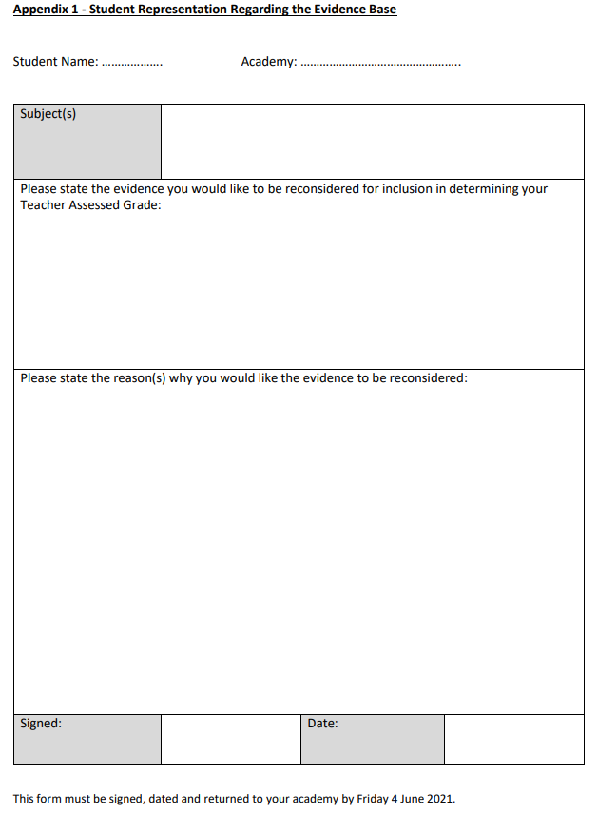
How to make a Representation

Slide 8
How to make a representation
Each representation will be reviewed a member of the Senior Leadership Team, including a potential discussion with some or all of the following stakeholders; the student, parent, Head of Department, Teacher Head of Year 11.
The appointed member of SLT will liaise with the subject teacher and Head of Department and will review the submission.
In the majority of cases it is hoped that students will have already had the opportunity to complete an alternative assessment, practical performance or identified sections of NEA.
If the proposed evidence is not suitable to be considered due to the student’s circumstances, alternative evidence will be sought to replace the initial evidence. This is to ensure a wide spread of evidence is used to determine the TAG. This is likely to include the sitting of a ‘shadow’ examination paper or other appropriate sources of evidence.

Slide 9
How to make a representation
If the proposed evidence did not include reasonable adjustments that would be expected to be in place, the teacher will take this into consideration in determining the TAG.
Once the alternative evidence or mitigation has been discussed and agreed, the appointed member of SLT with the Head of Department and teacher will submit their alternative evidence or mitigation to appointed member of the Senior Leadership team.
The member of the Senior Leadership team that has the responsibility for reviewing mitigation decisions will check the evidence and liaise with the Headteacher for consideration and review.

Slide 10
How to make a representation
If approved, the student will be informed of the alternative evidence or mitigation to be used.
If it is not approved, a further conversation will be held with the student, with Senior Leadership involvement where necessary.
Throughout the discussions, the student will be supported in the process with help and advice provided by parents/carers or another trusted adult as appropriate.
We will ensure students are comfortable and in agreement with the evidence that will be considered for their TAGs.

Slide 11
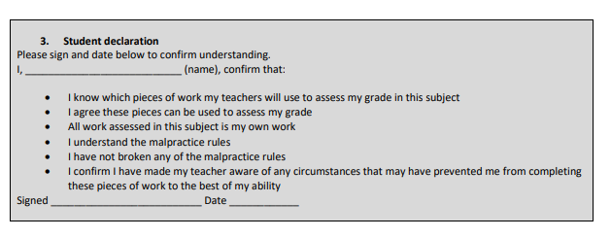
Declaration
All students will be asked to sign and date a declaration to confirm the work they have completed is their own work and they agree to the evidence used to produce their TAGs.

