Slide 1
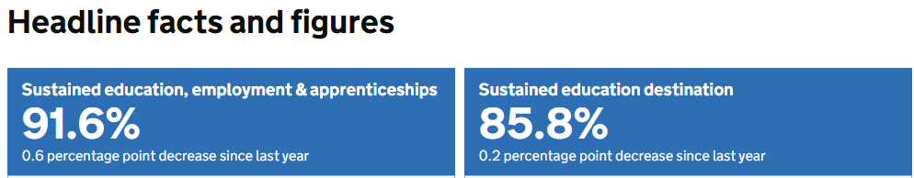
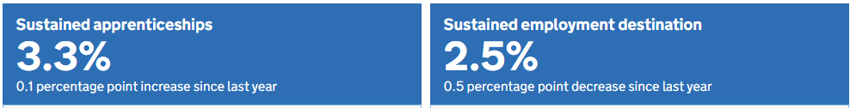
2023 NEET student's v national average (all students)
Royds Figures for 2023
Sustained education, employment & apprenticeships
95.25
Sustained education destination
89.47
Sustained apprenticeships
5.26
Sustained employment
0.58
This is the destinations for pupils from state funded mainstream schools who left key stage 4 in 2022/23 and follows their destinations in 2023/24.
5.6% of pupils did not have a recorded sustained destination in the year after key stage 4 (NEET) and 2.8% of pupils had an unknown destination
0.58% of pupils did not have a recorded sustained destination in the year after key stage 4 (NEET) 4.08% of pupils had an unknown destination
Overall outcomes (positive destinations) National: 91.6%Royds: 95.25%. Royds is higher by 3.65% Royds is performing better than the national average in getting students into sustained education, employment, or training.
Apprenticeships - National: 3.3% Royds: 5.26%. Royds is higher by 1.96 % Royds has a notably stronger uptake of apprenticeships, suggesting effective careers guidance and pathways beyond traditional education.
Employment - National: 2.5% Royds: 0.58% Royds is lower by −1.92 %. Fewer students go directly into employment. This likely reflects the stronger push toward education or apprenticeships rather than being a negative.
NEET (no sustained destination)National: 5.6% Royds: 0.58% Royds is dramatically better −5.02 points% This is a major strength—very few students from our school become NEET compared to the national picture.

Slide 2
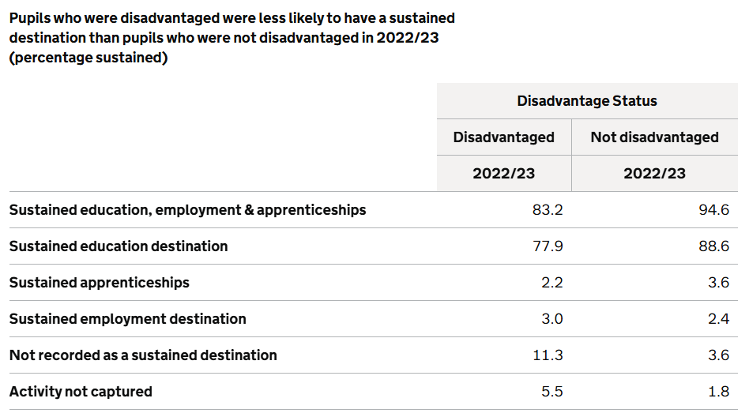
National data - DISADVANTAGED
Royds Data - DISADVANTAGED
Sustained education, employment & apprenticeships 94.53
Sustained education destination 87.68
Sustained apprenticeships 6.85
Sustained employment destination 0
Not recorded as a sustained destination 1.37
Activity not captured 4.11
Overall sustained destinations - National: 83.2% Royds: 94.53% Royds higher by +11.33 %. A very strong outcome — disadvantaged pupils at Royds are far more likely to move into sustained education, employment, or training than nationally.
Sustained education - National: 77.9% Royds: 87.68% Royds higher by +9.78 % Our disadvantaged students are significantly more likely to remain in education, showing strong post-16 progression support.
Apprenticeships National: 2.2% Royds: 6.85% Royds higher by +4.65 % This is a standout strength — disadvantaged pupils at Royds access apprenticeships at more than triple the national rate.
Employment National: 3.0% Royds: 0% Royds No disadvantaged pupils go directly into employment. As before, this likely reflects a strong focus on education and apprenticeships rather than a weakness.
Not recorded (NEET-type measure)National: 11.3% Royds: 1.37%. Royds better by −9.93 % This is a major strength — dramatically fewer disadvantaged pupils fall into NEET or untracked sustained destinations.

Slide 3
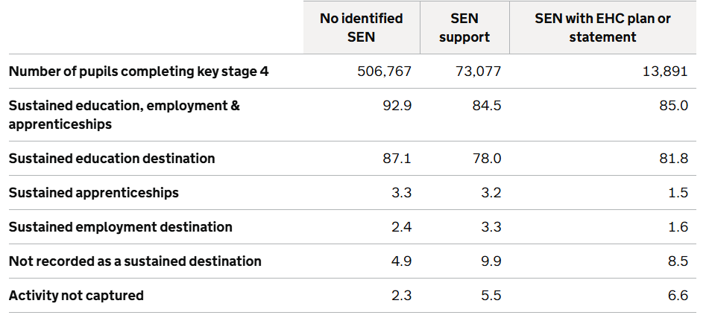
SEND Destinations
SEND Support EHCP
Sustained education, employment & apprenticeships 91.3 100
Sustained education destination 86.95 100
Sustained apprenticeships 4.35 0
Sustained employment destination 0 0
Not recorded as a sustained destination 4.35 0
Activity not captured 4.35 0
Overall sustained destinations for SEND Support - National: 84.5% Royds: 91.3% Royds higher by +6.8 %.
Overall sustained destinations for EHCP - National: 85% Royds: 100% Royds higher by +15 %.
Sustained education for SEND Support - National: 78% Royds: 86.95% Royds higher by +8.95 %
Overall sustained destinations for EHCP - National: 81.8% Royds: 100% Royds higher by +18.2 %.
Apprenticeships for SEND Support - National: 3.2% Royds: 4.35 % Royds slightly higher
Apprenticeships for EHCP - National: 1.5% Royds: 0%
Employment for SEND Support -National: 3.3% Royds: 0% Royds
Employment for EHCP - National: 1.6% Royds: 0% Royds
Not recorded as sustained (NEET-type measure) for SEND Support - National: 9.9 % Royds: 4.35%.
Not recorded as sustained (NEET-type measure) for EHCP - National: 8.5% Royds 0%
SEND and students with EHCP pupils at Royds are far more likely to move into sustained education, employment, or training than nationally.

