Slide 1
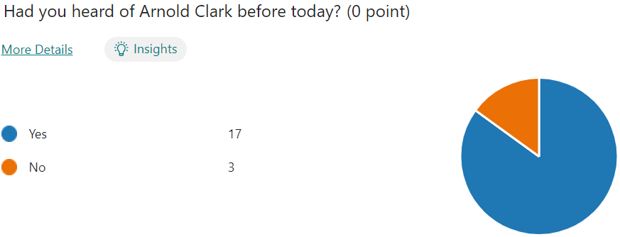
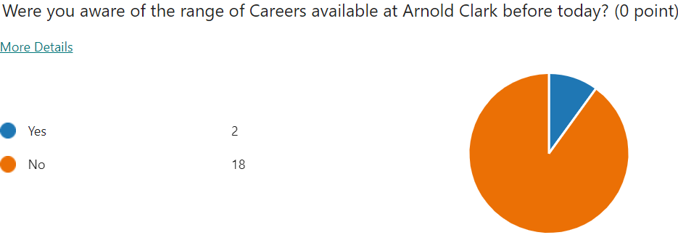
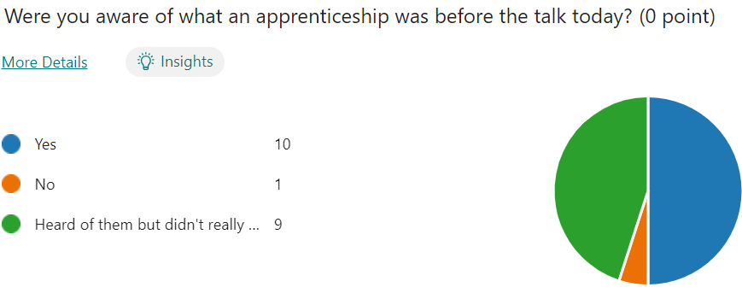
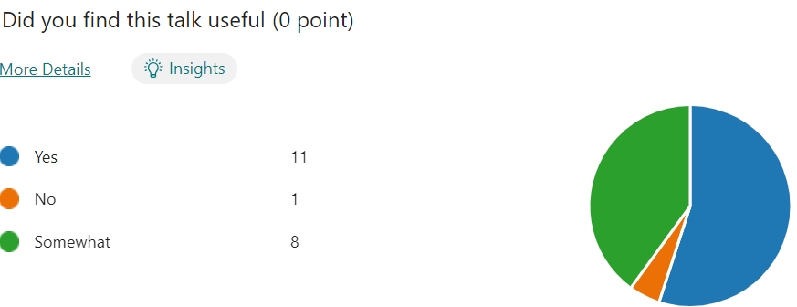
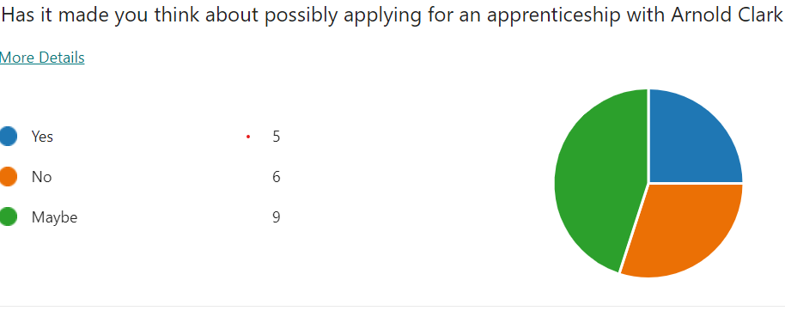
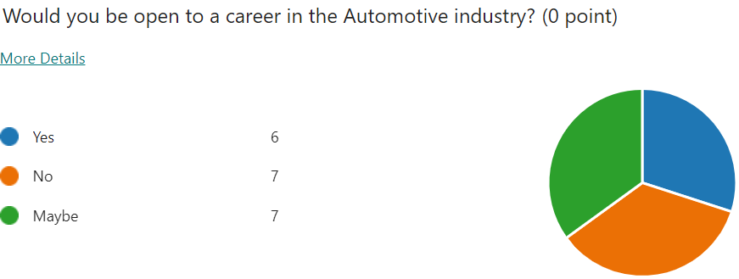
Feedback from students – Arnold Clark

Slide 2
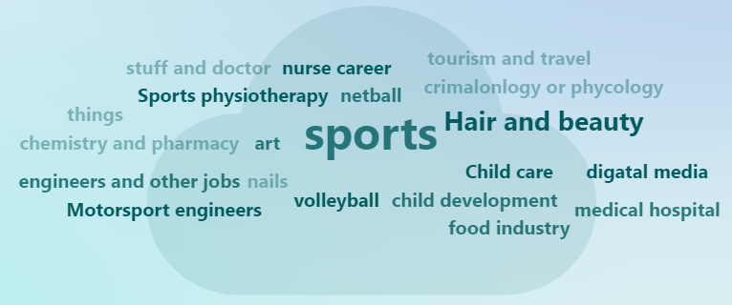
What did you enjoy most about the talk today
Getting to know about the different roles
How they can help if you have any problems
everything was explained clearly and she was really nice
That I learned something new about a company and what you can do there
Very informative, very reassuring for my future
lots of information about how arnold clark can help you with your education
I mostly enjoyed the many things you could do in Arnold Clarks
i enjoyed that there were so many jobs open there no matter if you was a girl or boys and there were many different jobs
everything
I enjoyed that we got to learn about a different type of industry that women can get into
i liked knowing that there was so many different options to work as and i enjoyed knowing how many women were in the industry.
was educational
how she was helpful and very kind towards us
knowing more about Arnold Clark and how it can help you pass your driving test.
What other Careers talks would you like to be involved in?

