Slide 1

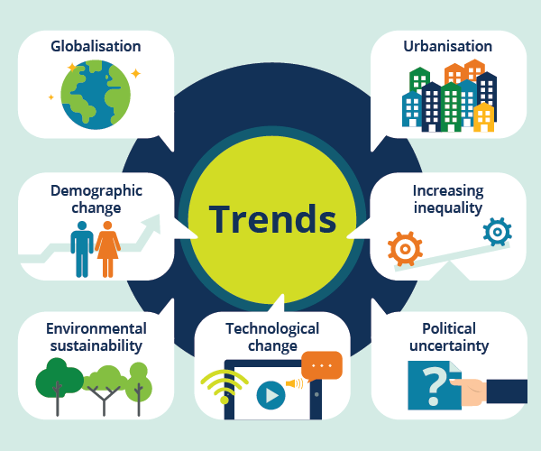
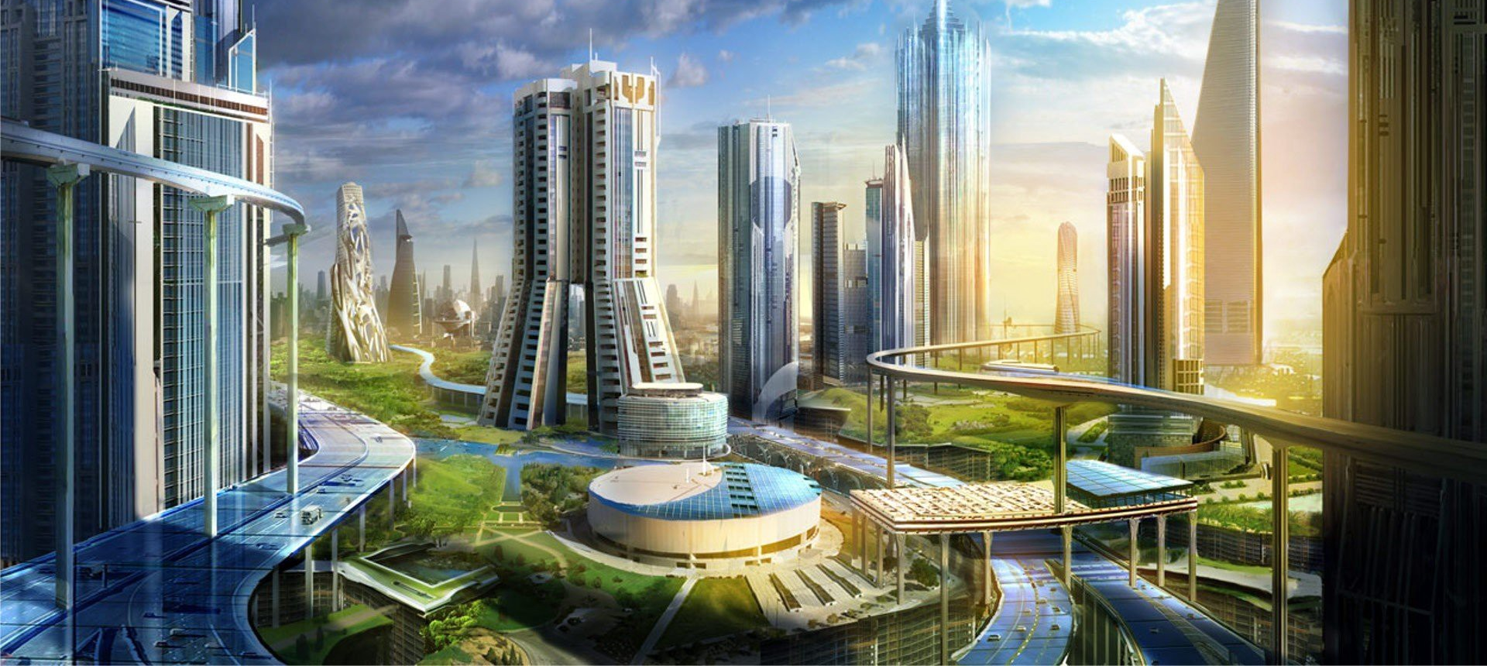
Jobs of the Future!
What will your Journey look like?

Slide 2


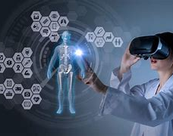
ART & DESIGN
Augmented Reality
Virtual Reality Designer
Augmented reality is about overlaying fictional digital elements onto real environments – like in Pokémon Go – while virtual reality is an entirely computer-generated world.
This is revolutionising not only the world of gaming but also tourism, medicine, education and many other areas of work and life.
Combined with technical skills, art and design students could use their creativity in this role to imagine the worlds we will occupy in these new augmented realities

Slide 3


Biology
Antibiotic Engineering
The widespread and sometimes reckless use of antibiotics to treat human and animal disease means that some bacteria are becoming resistant to the drugs we use to kill them.
We need to create new antibiotics to replace the old ones to avoid a return to the pre-antibiotic days when routine infections could lead to death.
Microbiologists create antibiotics by testing newly discovered chemical compounds to see if they can provide resistance to bacteria, so Biology students’ analytical and lab skills leave them well-placed to pursue a career in antibiotic engineering.

Slide 4


Computer Science
AI Engineers
AI is already playing a growing role in our world.
We’ve got virtual assistants like Siri and Alexa in our homes.
This is also the technology being used to develop self-driving cars.
Computer scientists use their programming skills to work on new forms of transport or help maintain the automated systems that make everything from food to computers.

Slide 5


PE
Health Data Analyst
With more and more data being collected about patients, it’s essential to have people who can interpret this.
Perhaps surprisingly, students learn data analysis skills when they study PE.
This helps students interpret the information that’s collected and allow them to make recommendations to improve the lifestyles of individual patients or groups of people.

Slide 6


Drama
Voice Actor
Video games are growing in popularity. The introduction of augmented reality (AR) and virtual reality (VR) will see this industry evolve in the coming years.
The characters that appear in these video games need voices. Players want to believe they’re interacting with a real person.
Businesses also need real people to provide the voices for their virtual assistants.
Drama students develop voice acting skills, providing opportunities to move away from traditional theatre

Slide 7
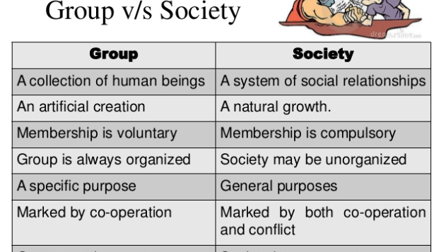
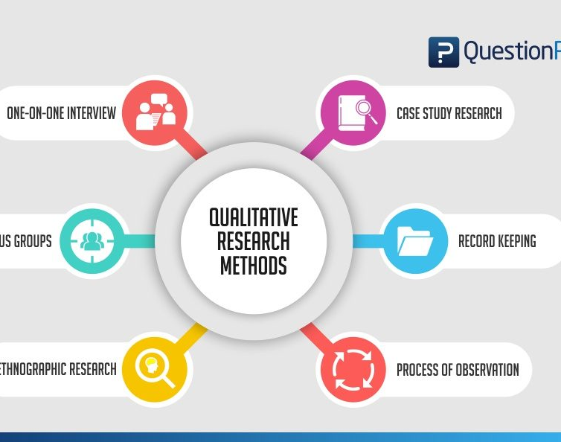
Sociology
Climate Change and Sustainability Researcher
As societies are forced to adapt quickly to the threats from climate change, someone is going to need to plan our way through the big social upheavals that will ensue, and help people adapt to very different ways of living.
Climate change and sustainability researchers will think about what the radically different societies of the future will look like and how we get from here to there as smoothly as possible. They will carry out quantitative and qualitative research through interviews, surveys and data analysis.

Slide 8


History
Futurist
A futurist works in the field of futurology.
It’s becoming more difficult to predict what’s going to happen and governments are looking for people who can provide reassurance on the best way to move forward.
History students’ critical thinking skills prepare them well for this role. They will communicate how the world is changing to the general public and explain how this might affect the global population.

Slide 9
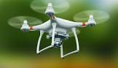
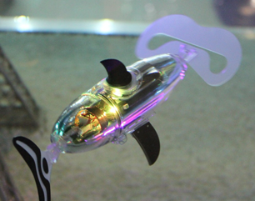
Geography
Aerial or Underwater Robot Operator
There’s exciting new technology for carrying out surveys, including remote-operated aerial drones, which can be used to assess disaster zones.
Remote-operated underwater vehicles can be sent to survey the deepest parts of the ocean and help us learn more about this fascinating environment.

Slide 10


Languages
Translator and App Developer
The need to communicate across borders is growing.
Linguists can use their language knowledge and skills to develop translation apps.
They can also help programmers think about user experience and cultural differences when creating apps to help support global communication.

Slide 11


English
UX and Human-machine interaction Designers
Every machine needs an interface.
Working out the best way for people to communicate with and operate new technology is a specialist job.
These professionals work with people as well as new technology to test ideas. Listening to and collecting feedback from end users and then explaining the changes that need to be made to designers is all part of the process.

Slide 12

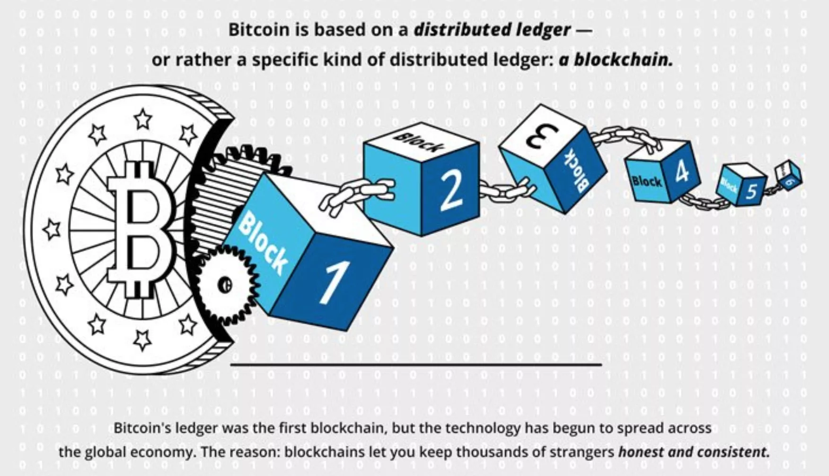
Maths
Blockchain Specialists
Blockchain is a system that works with cryptocurrencies, which are a form of digital money. Bitcoin is the best-known cryptocurrency, but there are many others.
With more businesses and individuals starting to use cryptocurrencies, there’s a need for people with mathematical and computing skills who can make this new financial system run smoothly.
Understanding cryptocurrencies will also be useful if you want to work in financial investment roles.

Slide 13


Design and Technology
Robotics Designer
According to the latest Future of Jobs report from the World Economic Forum, up to 37% of companies plan to invest in robots by 2022.
These vary from humanoid robots to stationary robots, and aerial or underwater robots.
Businesses in the oil and gas sector are investing in the development of aerial and underwater robots, which will need to be designed for a variety of tasks.
Design and Technology students could use their design skills to develop robots people enjoy interacting with?

Slide 14


Business
Automation Implementation Specialist
Automation poses a number of issues for businesses.
On the one hand it can make them more efficient and therefore profitable; on the other it’s expected to lead to job losses. Managing the transition to greater automation will need specific skills.
Businesses need to understand the new technology and how best to use it for their company. Automation implementation specialists need to manage people carefully, which might include retraining or upskilling workers who will lose existing jobs due to automation

Slide 15
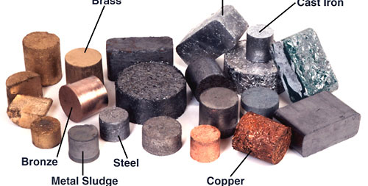

Chemistry
Organometallic Chemist
This is a field that’s expected to grow within chemistry.
It’s the study of chemical compounds that have metal-carbon bonds, as well as their reactions. It’s essential for many industrial processes.
Research in this area could lead to new processes or products in sectors like energy production and pharmaceuticals.

Slide 16

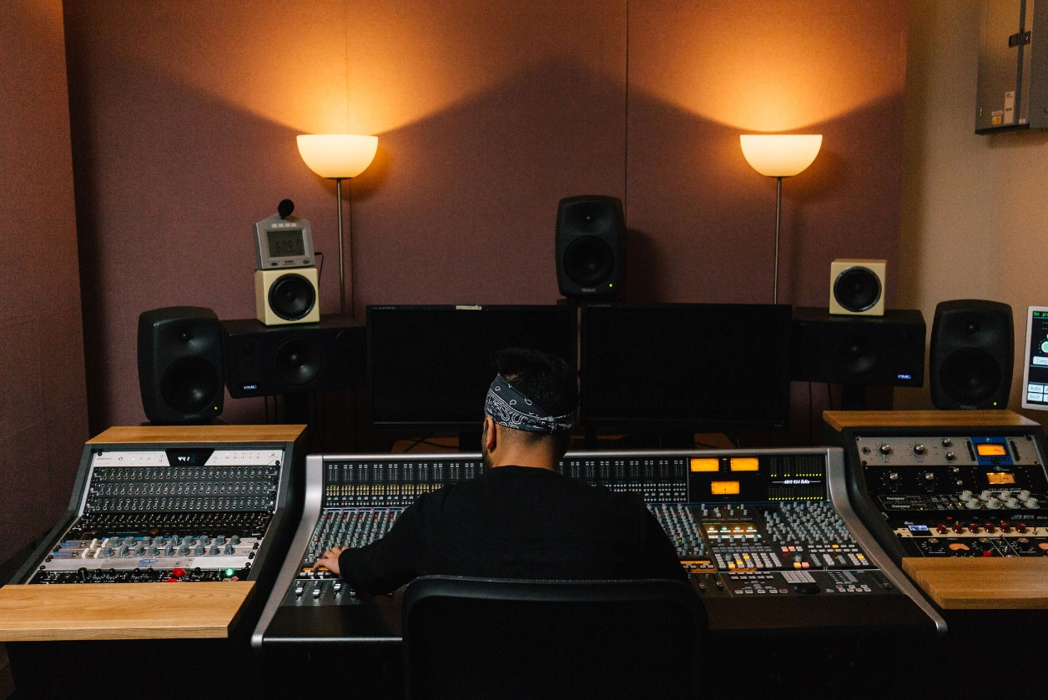
Music
Video Game Composer
As the universes and plotlines of video games become richer and more vivid, their soundtracks are increasingly taking on the character of film scores and the great orchestral works of the past.
Composers use their vast creativity and imagination, as well as their technical ability, to craft memorable and well- matched musical scores to complement the worlds evoked in video games.

Slide 17
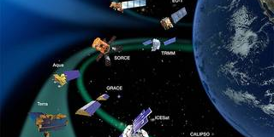

Physics
Satellite Developer
The UK’s space sector is one of the fastest-growing areas of our economy.
We rely on satellites for everything from our mobile phone networks to data about climate change.
Knowledge of physics principles is essential to develop working satellites.
Physicists use practical skills to test their ideas and communication skills to explain their findings to colleagues, partners and clients

