Slide 1

Notes:
This PowerPoint has been designed to act as a stand alone presentation when discussing our region and the local landscape OR used as an initial introduction to any of the other resources (Skills, Job Postings, Work Experience, Future Trends). You will also find downloadable versions of the information in this presentation.

Slide 2
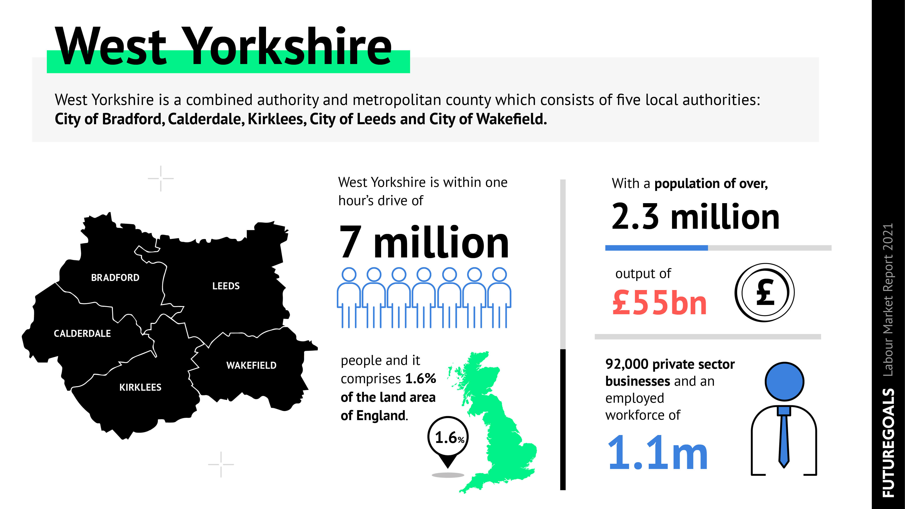

Slide 3
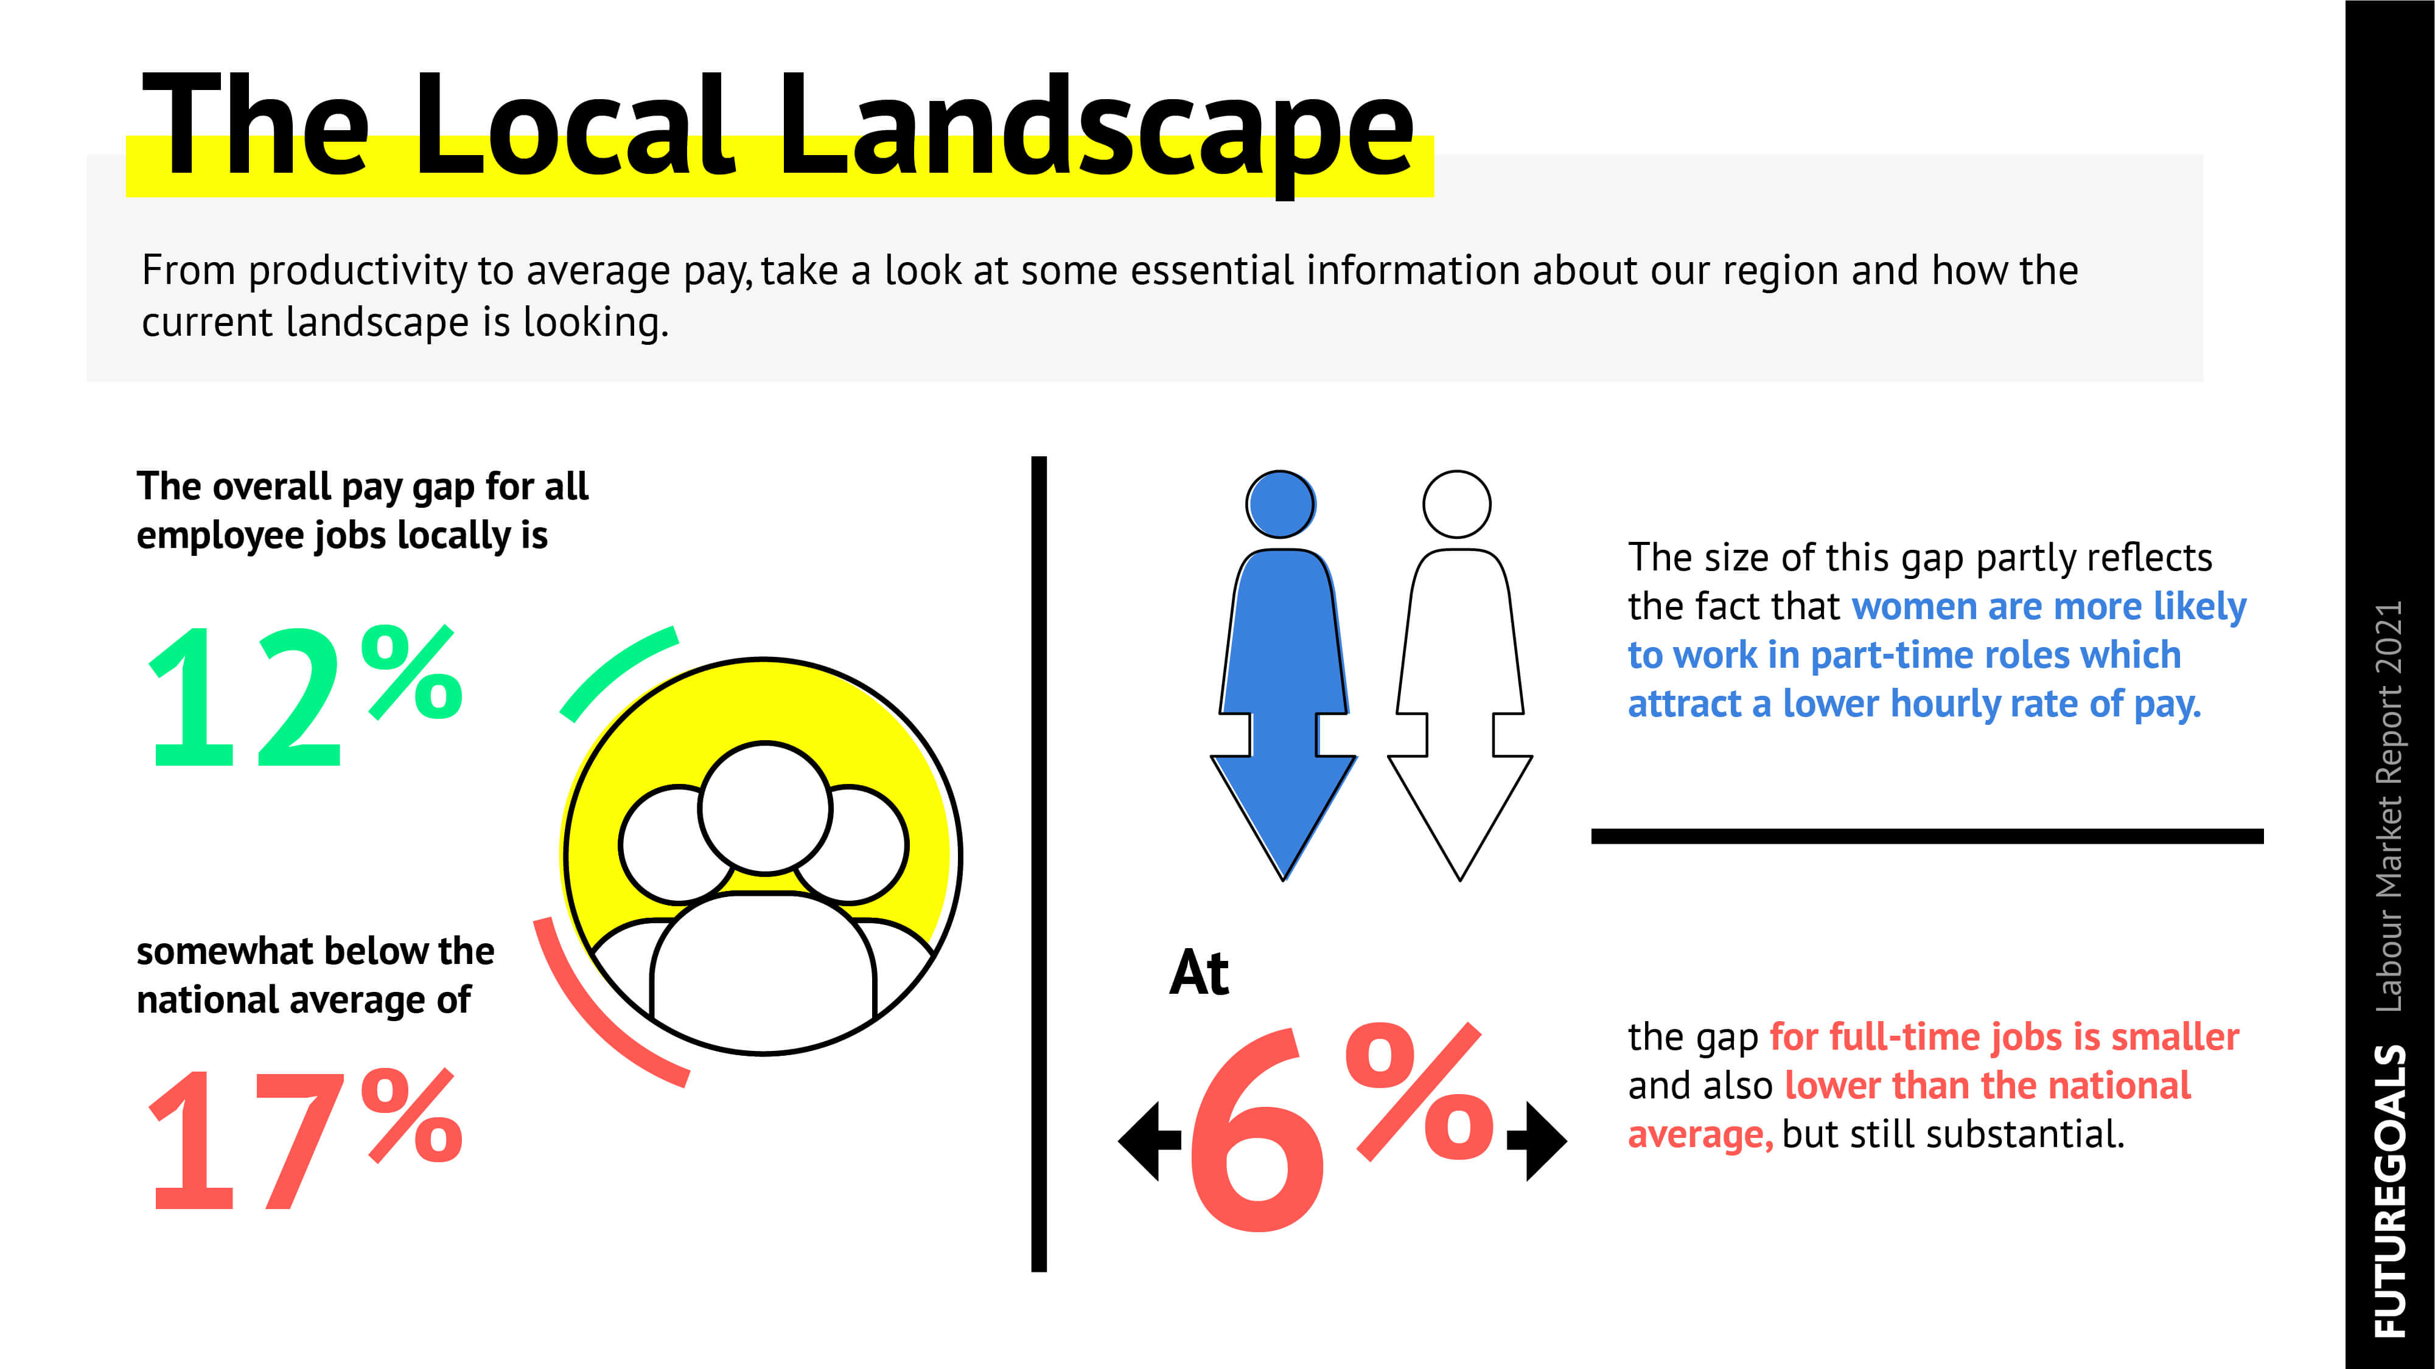

Slide 4

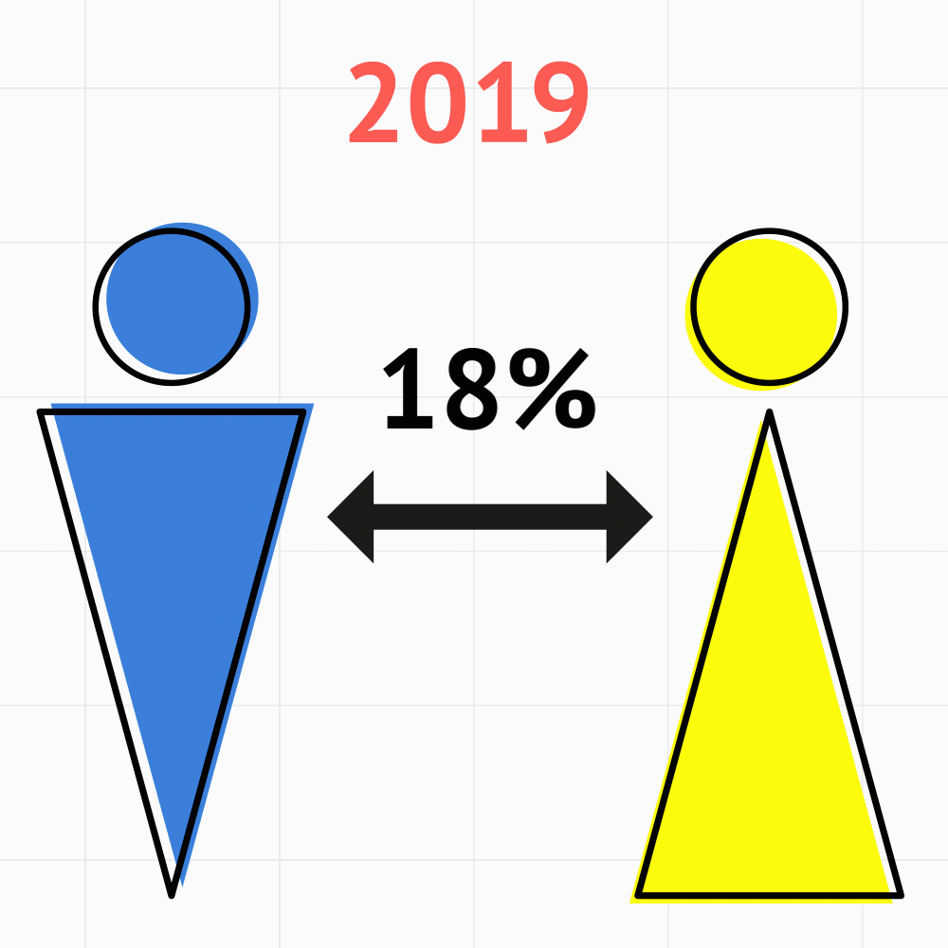

Slide 5
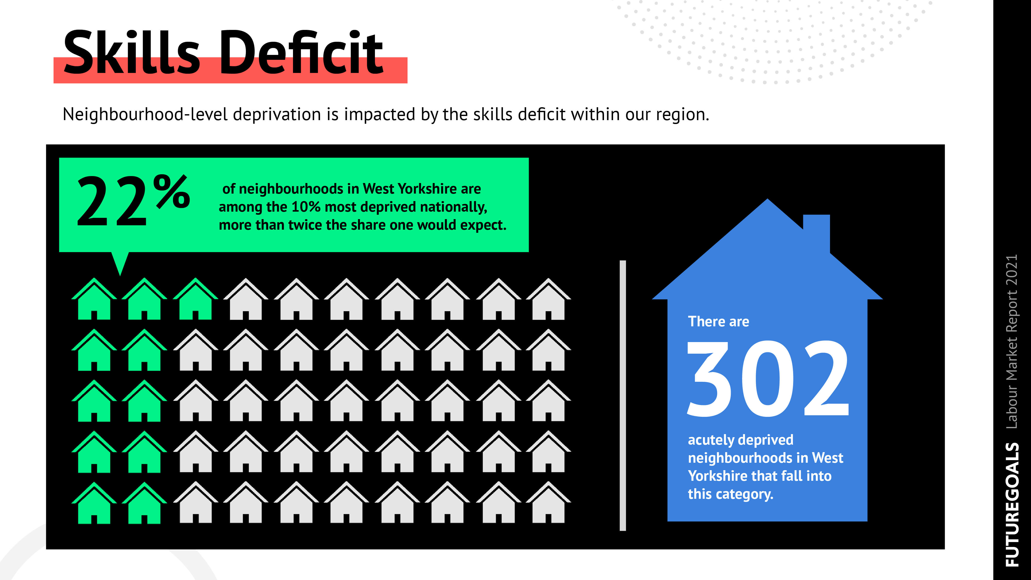

Slide 6
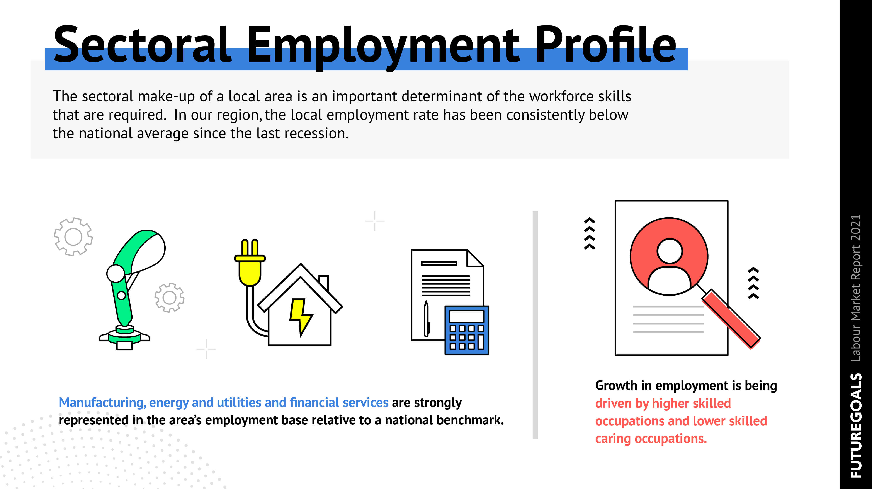

Slide 7


